Slide 1
Morning Coffee
Staying Healthy at Starbucks

Slide 2
Nutritional Guidance
Added Sugar
Men: 37.5 g/day max
Women: 25.0 g/day max

Slide 3
Nutritional Guidance
Added Sugar
Men: 37.5 g/day max
Women: 25.0 g/day max
Caffeine
400 mg/day max

Slide 4
Nutritional Guidance
Added Sugar
Men: 37.5 g/day max
Women: 25.0 g/day max
Caffeine
400 mg/day max
Cholesterol
300 mg/day max

Slide 5
Nutritional Guidance
Added Sugar
Men: 37.5 g/day max
Women: 25.0 g/day max
Caffeine
400 mg/day max
Cholesterol
300 mg/day max
Calories
Men: 2,000 - 3,200/day
Women: 1,600 - 2,400/day

Slide 6
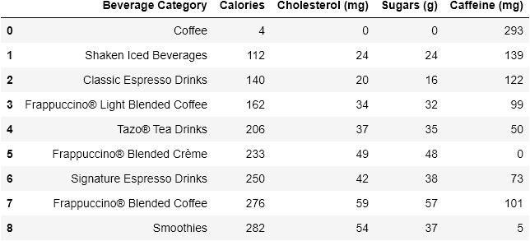
Data by Beverage Category

Slide 7
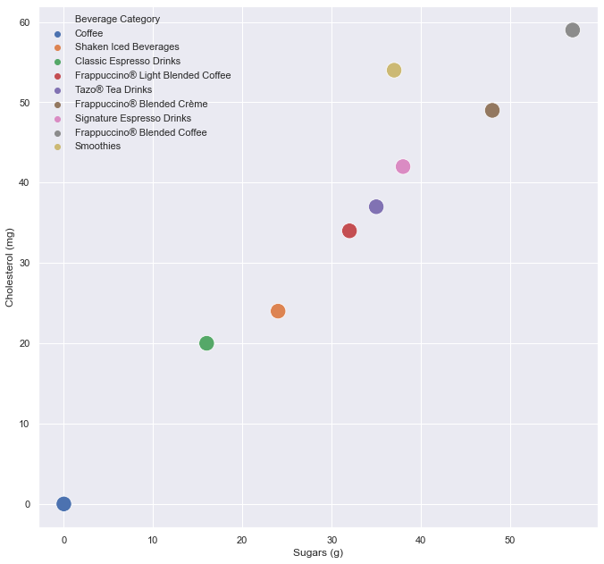
Visualizing Data - Sugar vs Cholesterol

Slide 8
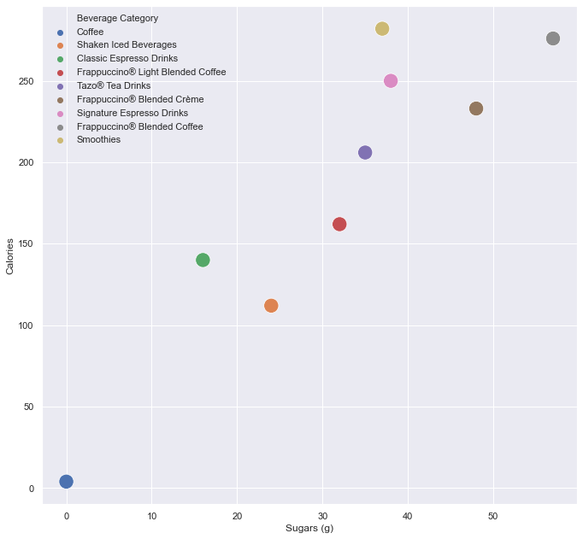
Visualizing Data - Sugar vs Calories

Slide 9
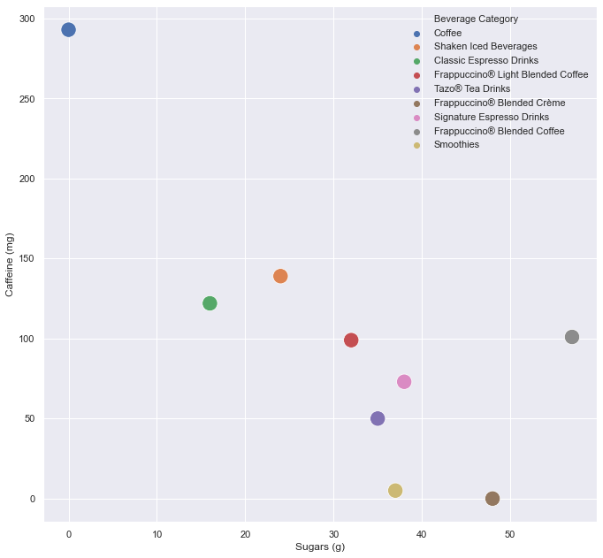
Visualizing Data - Sugar vs Caffeine

Slide 10
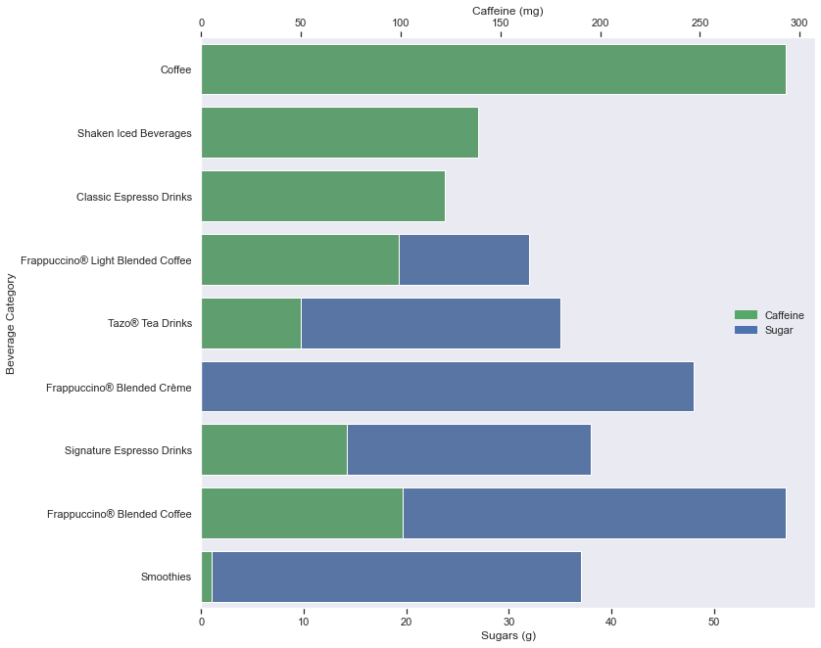
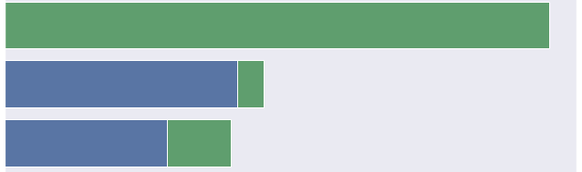
Visualizing Data - Sugar vs Caffeine

Slide 11
Summary
Healthiest Options:
Coffee
Classic Espresso Drinks

Slide 12
Summary
Healthiest Options:
Coffee
Classic Espresso Drinks
Unhealthiest Options:
Frappuccino Blended Coffee
Frappuccino Blended Creme
Signature Espresso Drinks
Smoothies

